Slide 1
MYSQL &
WORKBENCH

Slide 2
Development Environment
Download the MySQL Community Server and Workbench from:
MySQL Community Server
MySQL Workbench

Slide 3

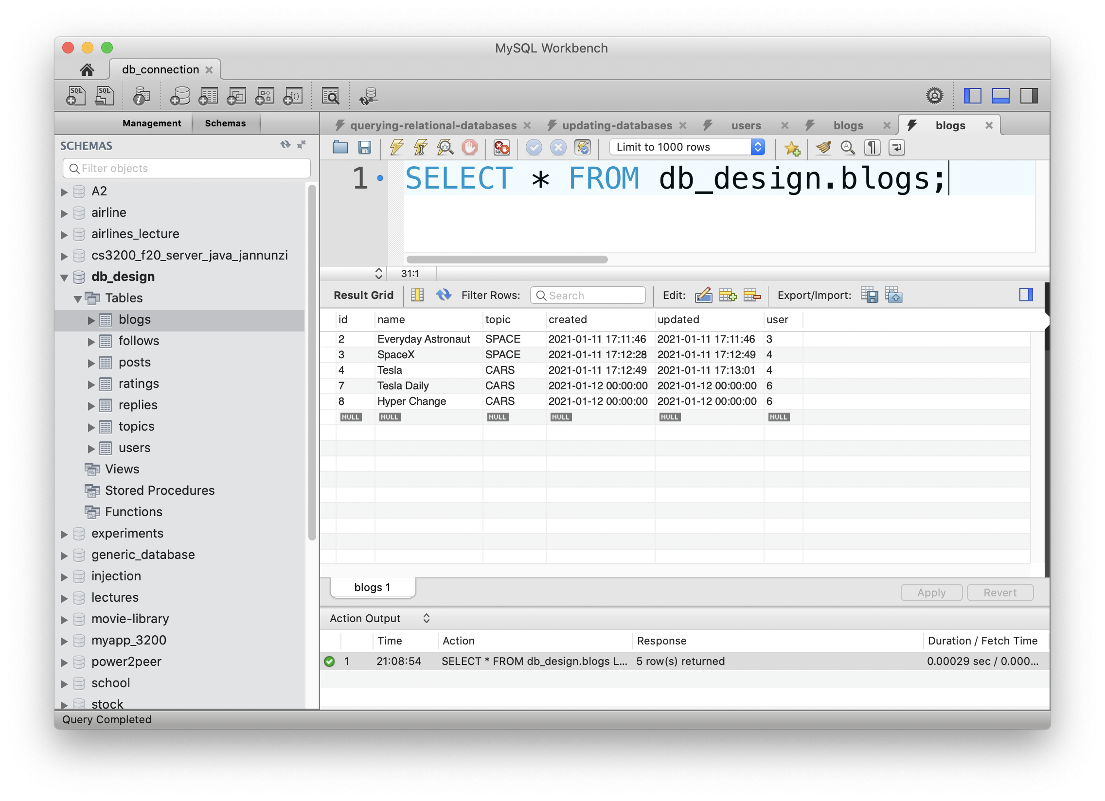
Database Client/Server Architecture
MySQL Workbench Data Files
(Database Client)
MySQL
Server
011010010011
010100010101
101110101001
101010100011

Slide 4
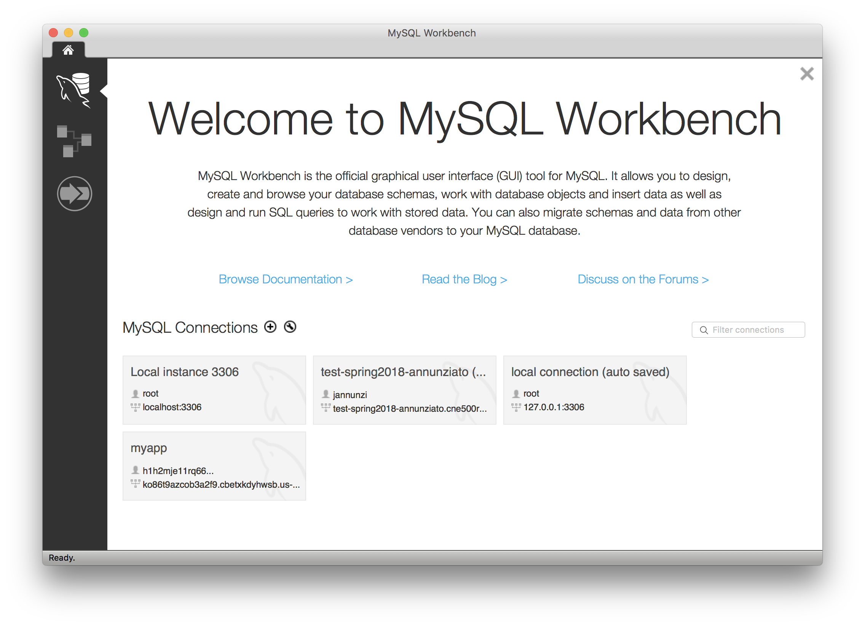

Slide 5
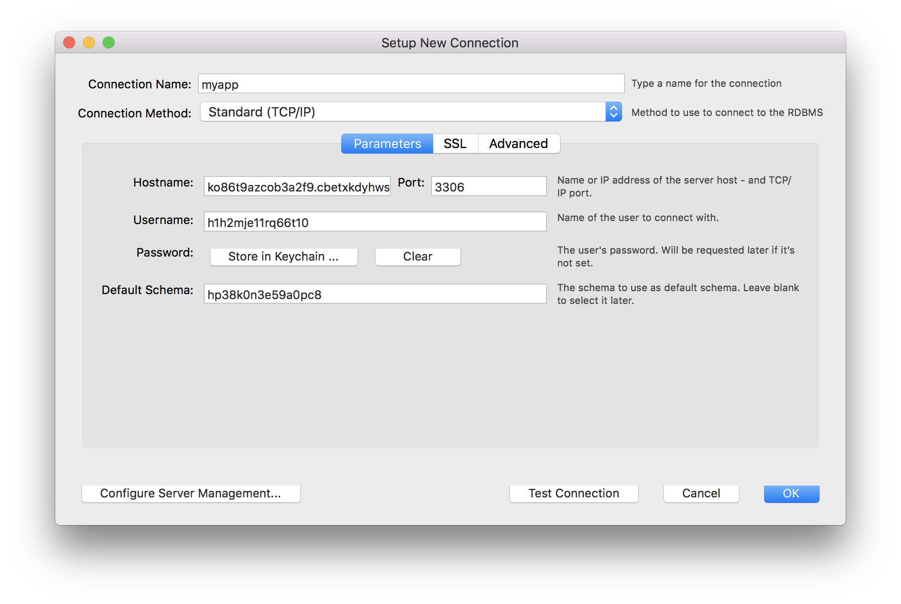
Configure Connection

Slide 6
YOUR connection name might differ

Slide 7
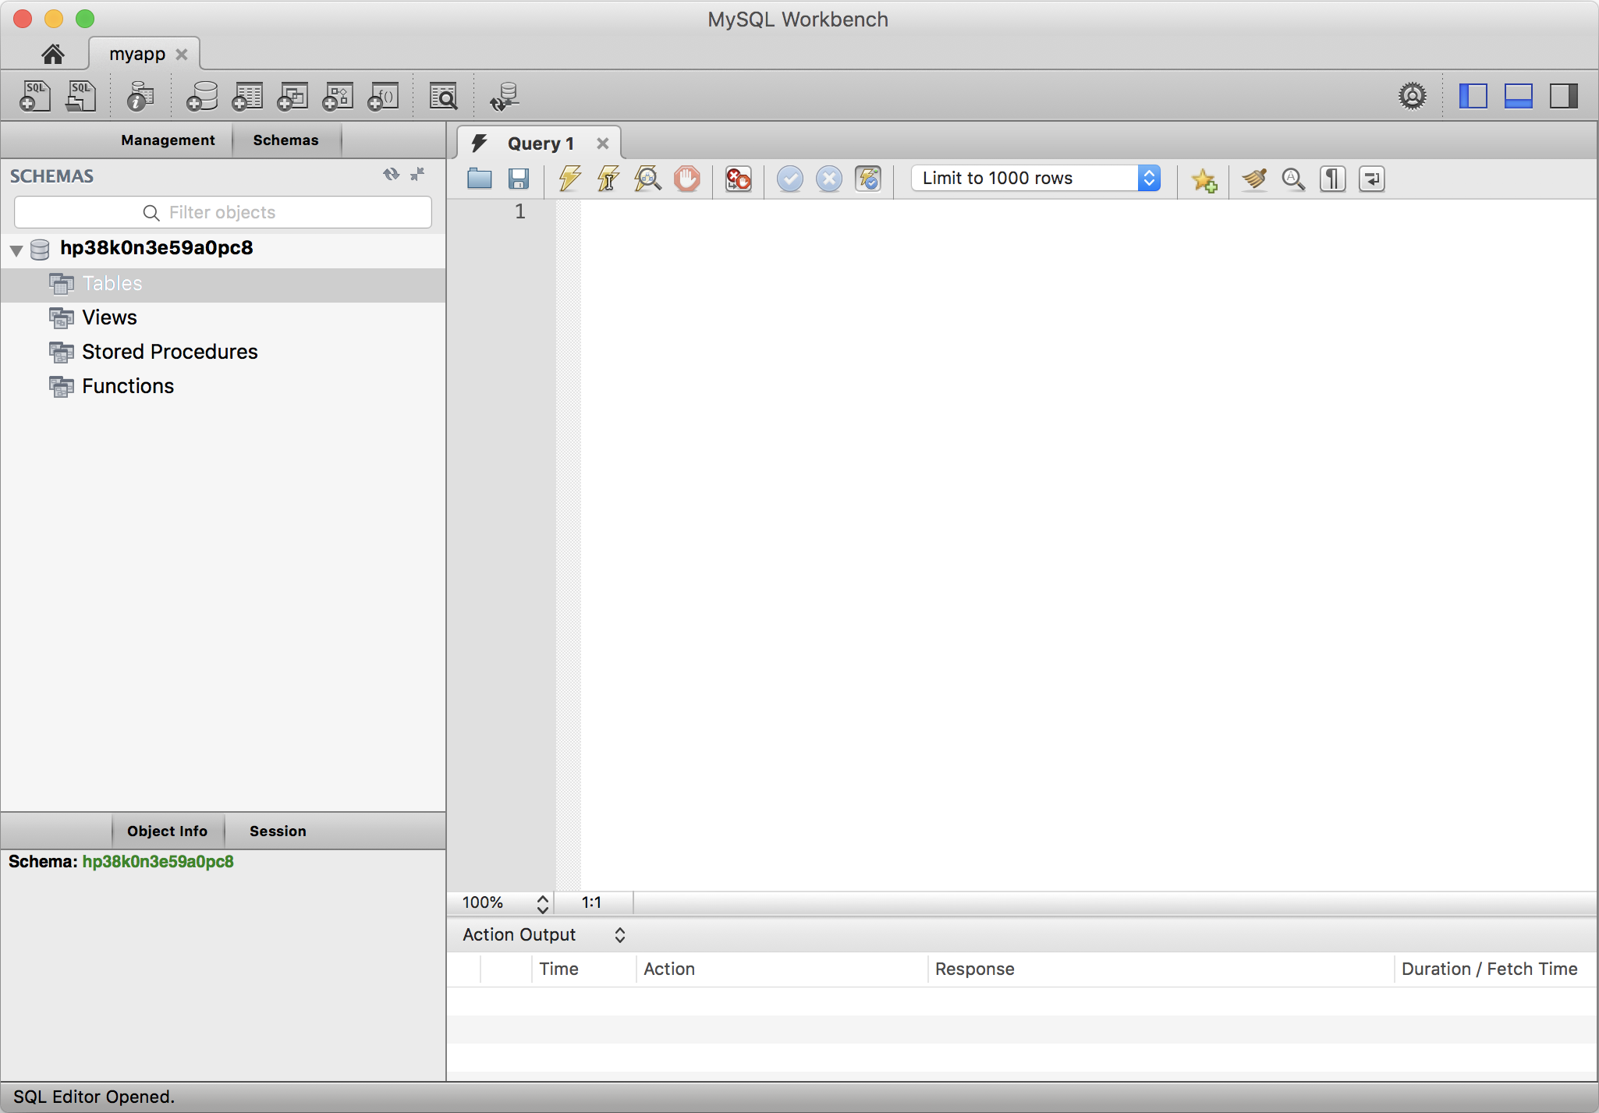
Main Window On macOS

Slide 8
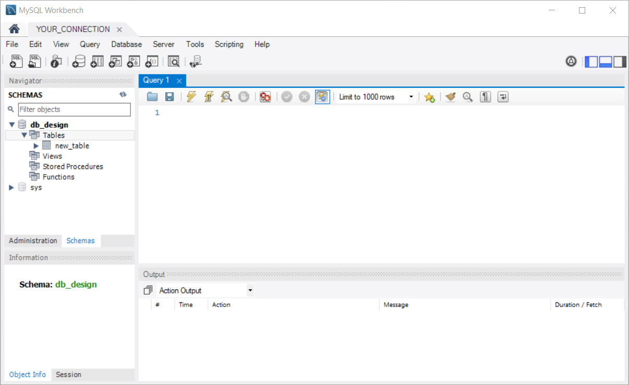
Main Window On Windows

Slide 9
SCHEMAS

Slide 10
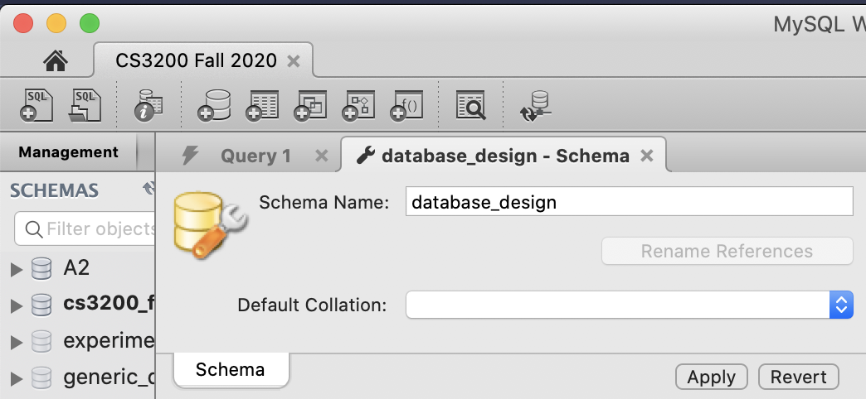
Create a Schema
If you don't already
have a schema,
create one with
MySQL Workbench

Slide 11
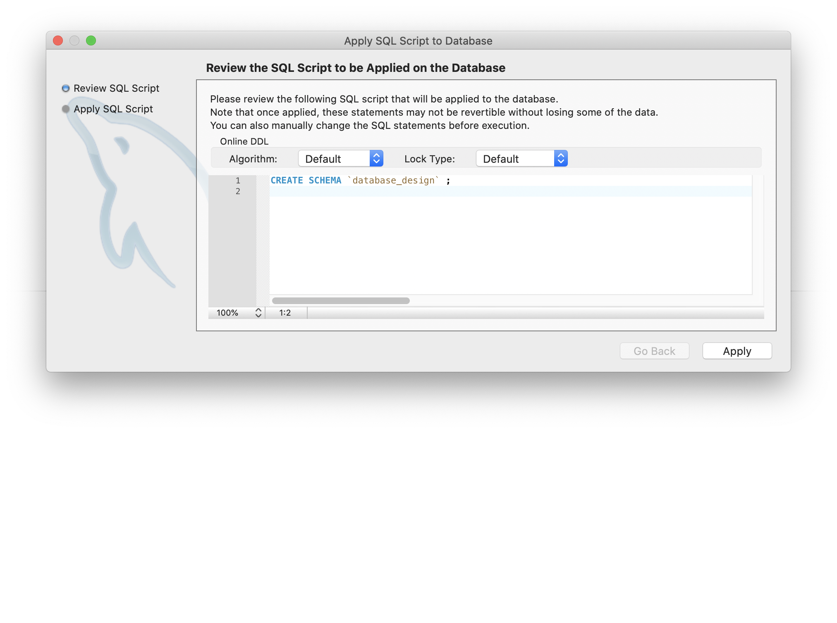
Apply Schema

Slide 12
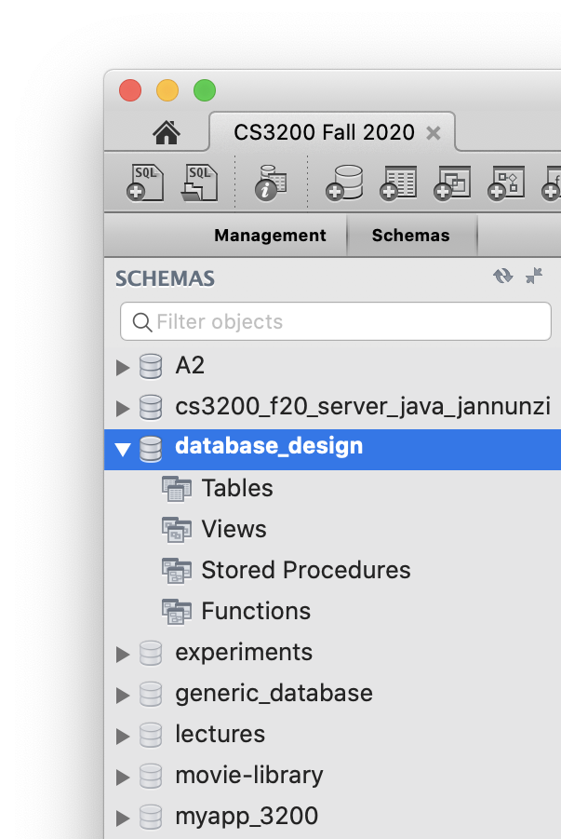
Select a schema as default
On the left hand side, under the Schemas tab, double click the schema you want to work with
This will now be your default schema when you issue SQL commands from now on

Slide 13
TABLES

Slide 14
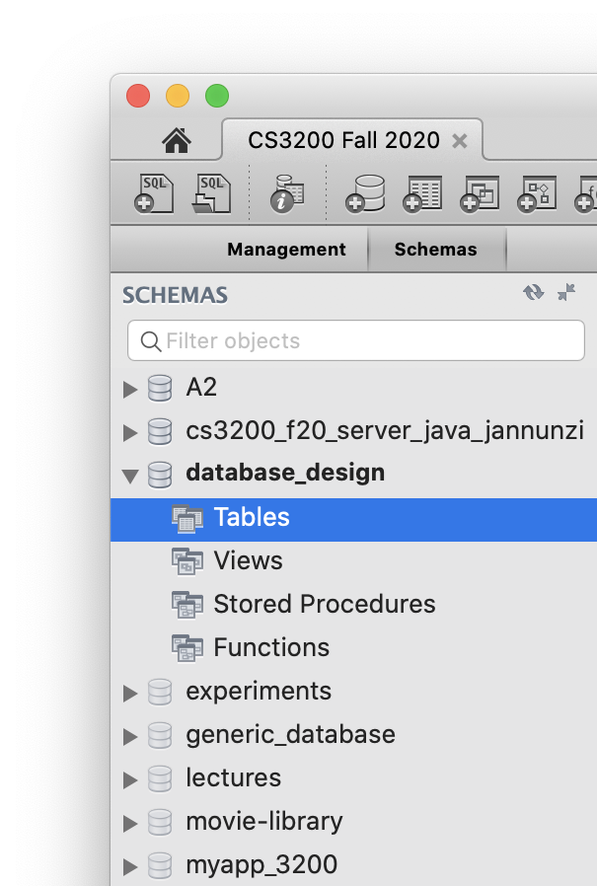
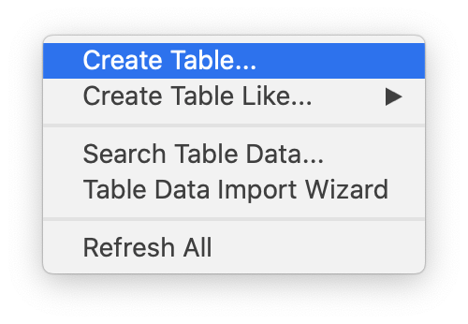
Create tables
You can create tables by either right clicking on Tables under your schema
OR clicking on the Add Table tool in the toolbar

Slide 15
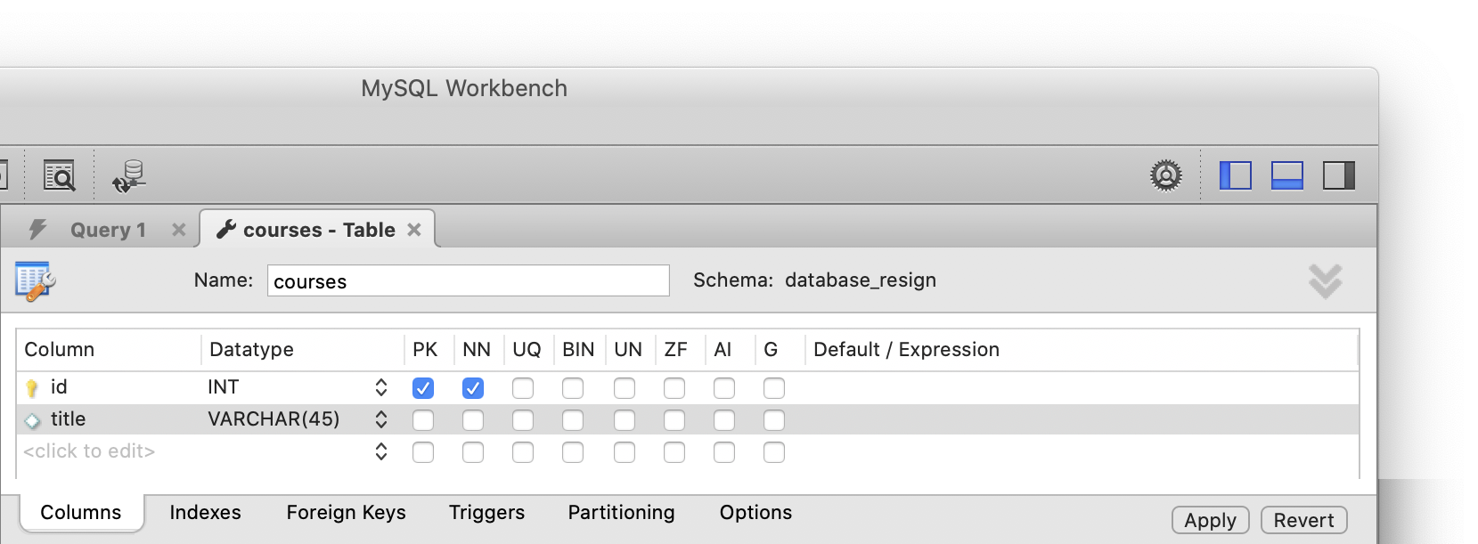
Create a courses table
Let's create a simple courses table to capture info about your courses
Table names should be nouns and plural

Slide 16
Review and Accept New Table
MySQL gives you a preview of the CREATE statement it'll use to create the table
You can review and then accept it by clicking Apply
CREATE TABLE `database_design`.`courses` (
`id` INT NOT NULL,
`title` VARCHAR(45) NULL,
PRIMARY KEY (`id`));

Slide 17
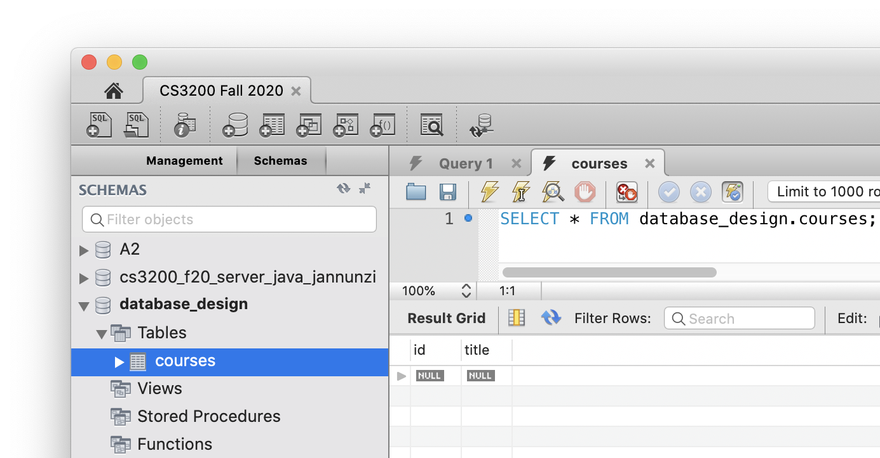
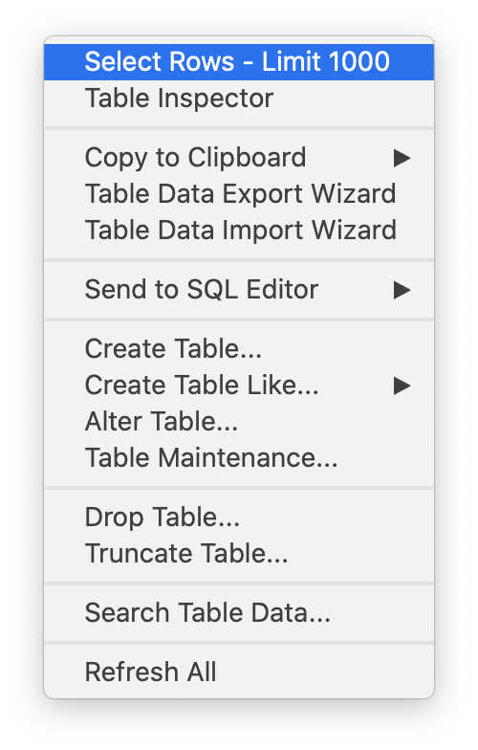
View Table's Data
You can view a table's data by right clicking the table and selecting: Select Rows - Limit 1000
The SELECT statement appears in a new SQL editor
Data appears in a Result Grid

Slide 18
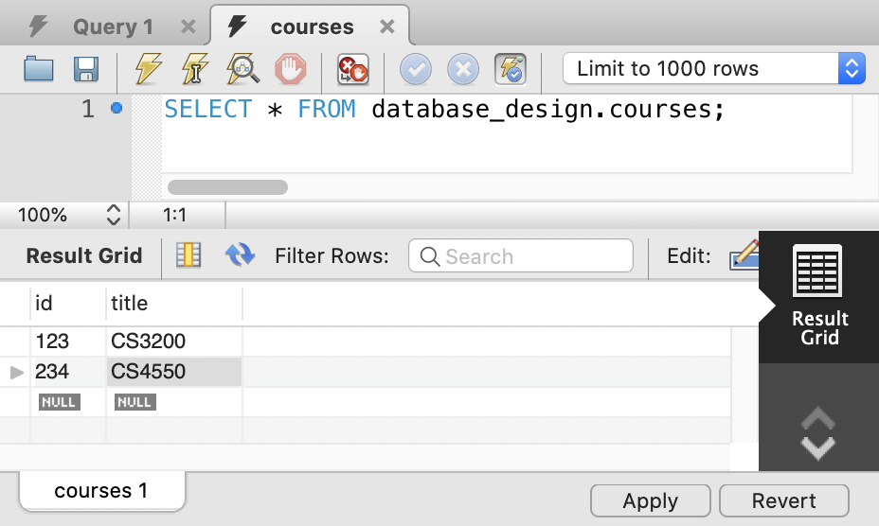
Inserting New Data in MySQL
To insert new data, you can type the INSERT statements in an SQL editor
OR you can also enter new data in a Result Grid
Press Enter key after every new data you enter
Press Apply when done

Slide 19
Review and Accept Insert Statements
MySQL gives you a preview of the INSERT statements it'll use to insert the data
Review and accept by pressing Apply
INSERT INTO `database_design`.`courses` (`id`, `title`) VALUES ('123', 'CS3200');
INSERT INTO `database_design`.`courses` (`id`, `title`) VALUES ('234', 'CS4550');

Slide 20
CREATING
A USER

Slide 21
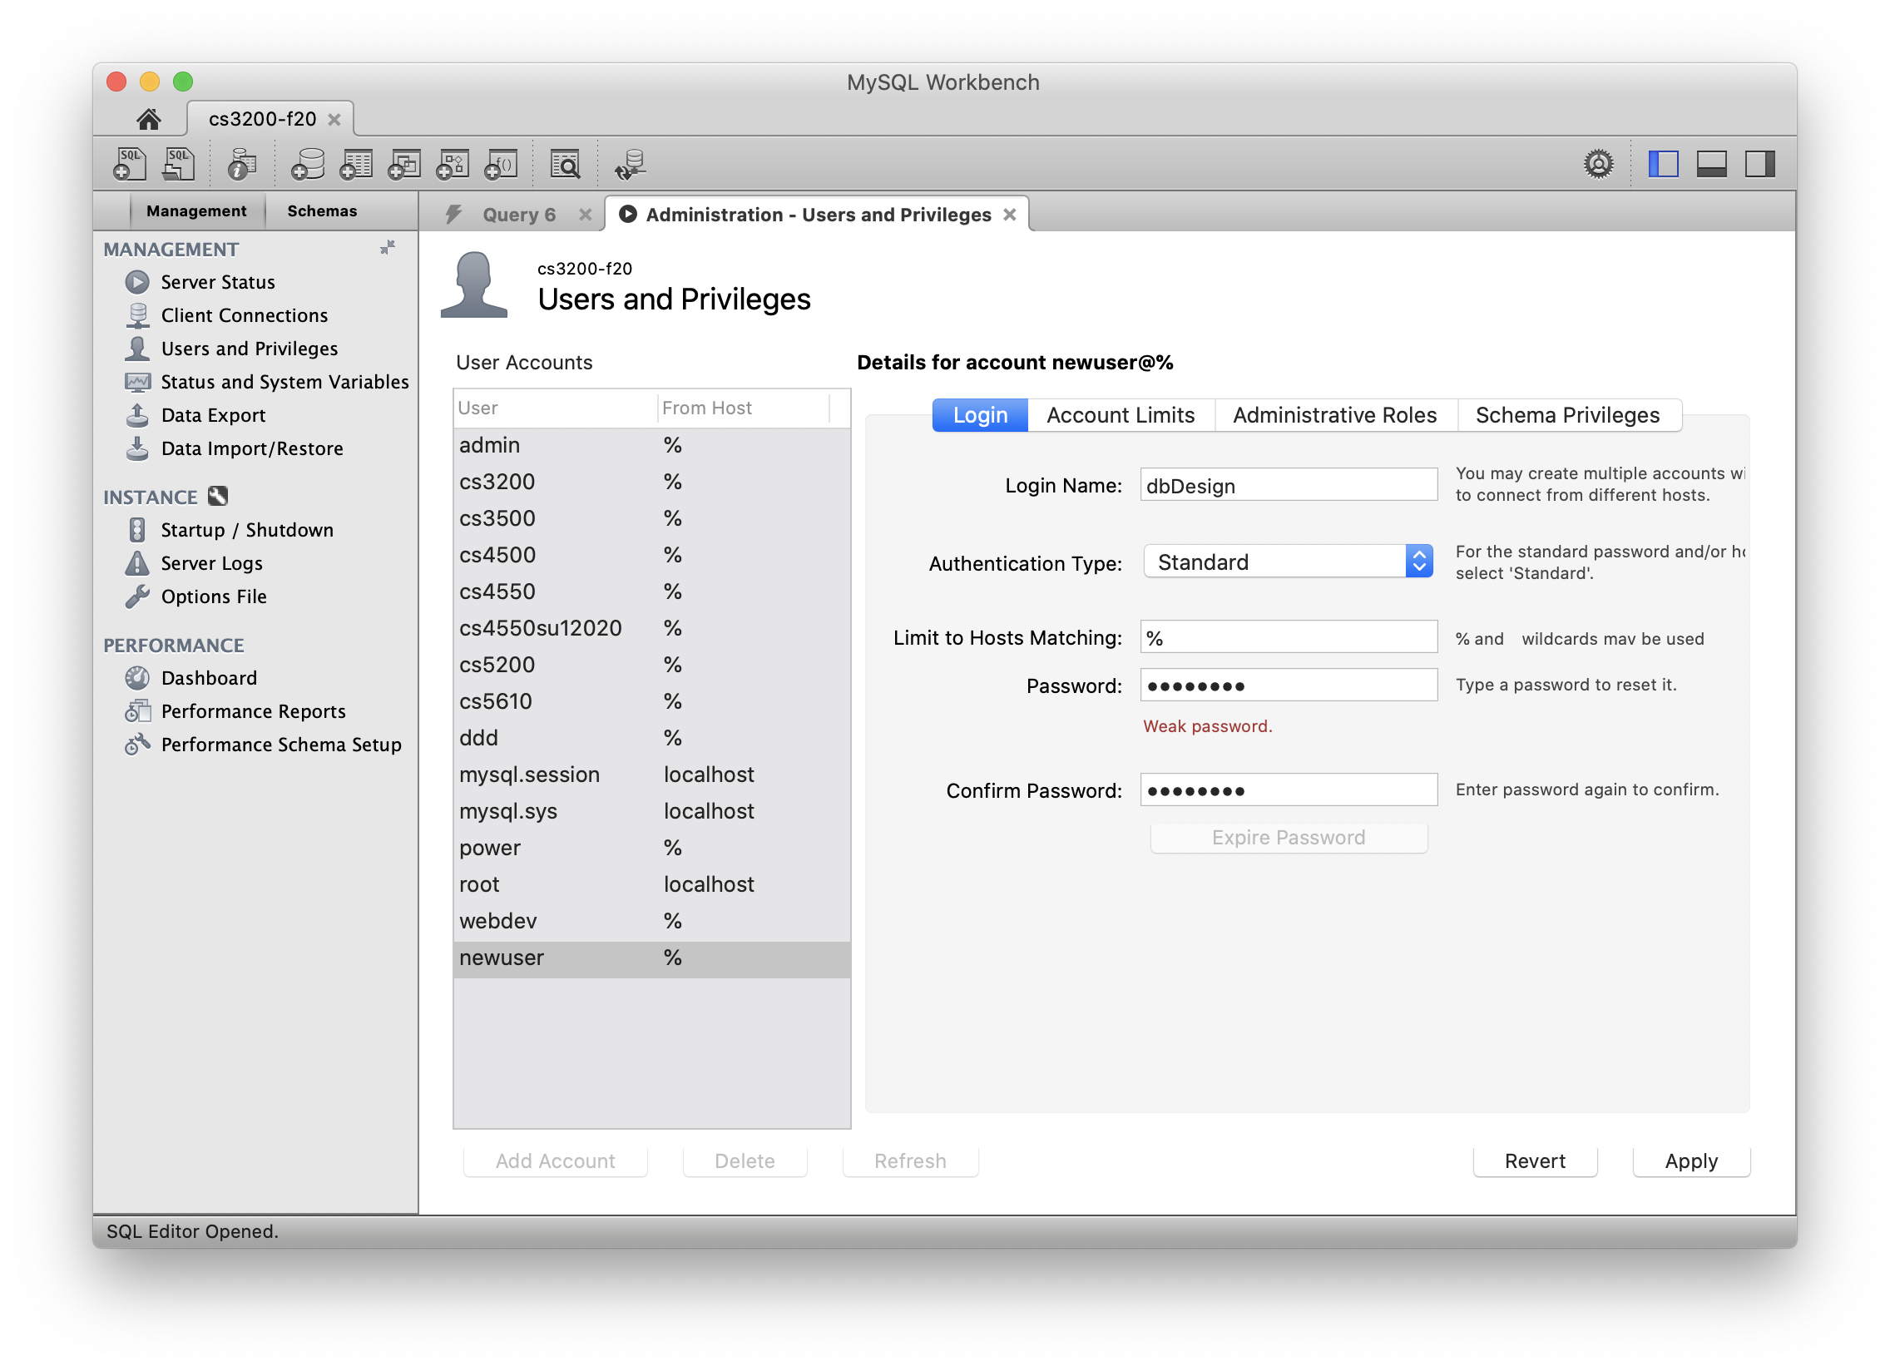
Create a User
Configure an account, e.g., username: dbDesign password: dbDesign
We'll use this account to connect from Java

Slide 22
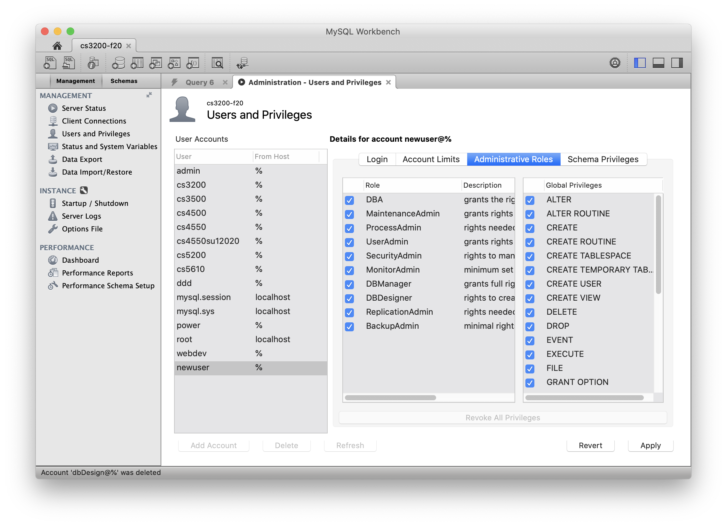
Make the user a DBA
Give the account all privileges making them a DBA
Database Administrator

